Slide 1
Neonatal Hypoglycemia
Dani Kraft, DNP, ARNP
Slides adapted from Jessie Marks, DNP, ARNP and Yvonne Griffin, CNM, MSN

Slide 2
Objectives
Identify infants at risk for hypoglycemia
Define large for gestational age (LGA), macrosomia
Understand pathophysiology and management of neonatal hypoglycemia
Describe the risk to the infant of a diabetic mother (IDM)

Slide 3
Hypoglycemia: Prevalence and Significance
Incidence hard to define
5-15% of healthy newborns
Up to 50% of newborns with risk factors
One of the most common reasons for NICU admission
Estimated $1.2 billion in annual health care costs in US
Impact – inpatient and beyond

Slide 4
Definitions
LGA: Large for gestational age
>2 SD above weight for GA, or >90%ile on growth charts
Fenton, Olsen, WHO etc.
Macrosomia:
Infant with birthweight >4000g or >4500g, depending upon source.
8-14% in uncomplicated pregnancies, 25-45% in diabetic pregnancies
SGA: Small for gestational age
>2 SD below mean for GA, or <10%ile on growth charts
IUGR: Intrauterine growth restriction
Utero environmental/genetic causes
Late preterm
34-36 weeks gestation*

Slide 5
Glucose Homeostasis
Brain is dependent on constant supply of blood glucose (BG)
When BG concentrations decrease, glucagon secretion stimulates the liver to release glucose into the bloodstream (glycogenolysis).
In time of starvation, can also use glycogen from muscle cells/fatty acids

Slide 6
Normal Newborn Glucose Homeostasis
Low BG levels after birth common in the first 1-2 hours
Normal adaptation to postnatal life
Most infants compensate for transient low glucose.
After initial decrease in glucose levels, glucose levels rise and become more stable around 12 hours of life (usually > 45 mg/dl)

Slide 7
Challenges in Newborn Glucose Homeostasis
Inadequate glycogen stores/source for gluconeogenesis
Liver stores rapidly depleted.
Prematurity, small for gestational age (SGA), intrauterine growth restriction (IUGR), perinatal stress, polycythemia
Hyperinsulinism
Infant of a diabetic mother (IDM)
Other
Sepsis, cortisol deficiency, inborn error of metabolism, growth hormone deficiency
Notes:
In newborn: Liver stores rapidly depleted. Limited muscle stores/fatty acids.

Slide 8
Postnatal Glucose Levels
IDM infants may experience neonatal hypoglycemia as early as 1 hour of life, usually by 12 hours of life
SGA and LGA infants may develop hypoglycemia around 3 hours of life , are at risk for persistent hypoglycemia for up to 10 days after birth

Slide 9
American Academy of Pediatrics (AAP) vs Pediatric Endocrine Society (PES)
AAP PES
Target glucose level greater than or equal 45
Screen: Late preterm, SGA, LGA, IDM
Focus: First 24 hours, transitional
Target glucose level above 50 during first 48 hours
Following glucose levels above 60
Screen: AAP plus perinatal stress, maternal pre-eclampsia, post mature delivery
Focus: 24-48 hours

Slide 10
Signs/Symptoms of Hypoglycemia
Irritability
Tremors/jitteriness, exaggerated Moro reflex
High-pitched cry, floppiness
Cyanosis, apnea
Poor feeding
Can also be asymptomatic

Slide 11
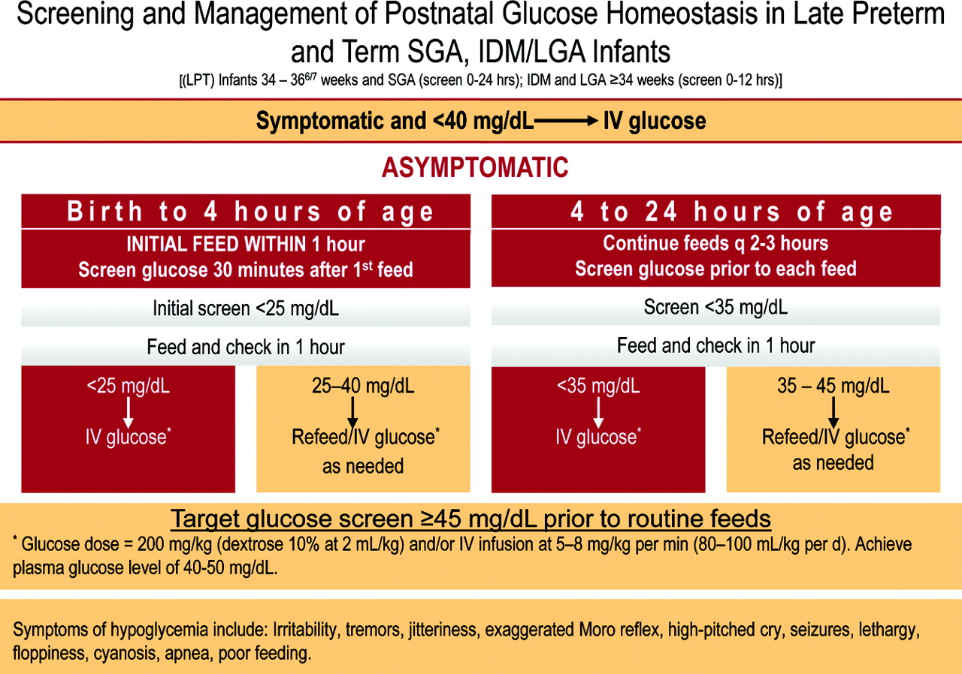

Slide 12
Case Study #1
A 38w2d infant born via vaginal delivery to a G2P1 mother has a birth weight of 4200g. Mother had a normal pregnancy with normal glucose tolerance test done during the third trimester.
Risk factors?
At birth infant does not have any signs of hypoglycemia. What is the next step per AAP guidelines?
Initial feed within 1 hour, check serum glucose 30 minutes after 1st feed
Notes:
LGA.

Slide 13
Case Study #1 Continued
The infant's initial screen is 26 mg/dl. According to the AAP, what is the next step?
Feed infant and recheck BG in one hour
Repeat blood glucose is 46. Next steps?
Continue feeds every 2-3 hours with glucose checks prior to feeds for at least 12 hours

Slide 14
Management: Glucose Gel
Not Currently in AAP Guidelines
Dextrose gel
200mg/kg
Massaged into buccal mucosa
Administer and feed

Slide 15
Management: Glucose Gel
Two clinical trials, three observational studies
Sugar Babies Study (2011)
Reduction in NICU admissions from 8.1% to 3.7%
Improvement in exclusive breastfeeding rates from 6% to 19%
Gregory et al. (2019)
Use of gel decreased NICU admissions for hypoglycemia
Gel raises blood glucose, degree of the rise differs by feeding type provided with gel
Pregel blood glucose may guide feeding choice for infants

Slide 16
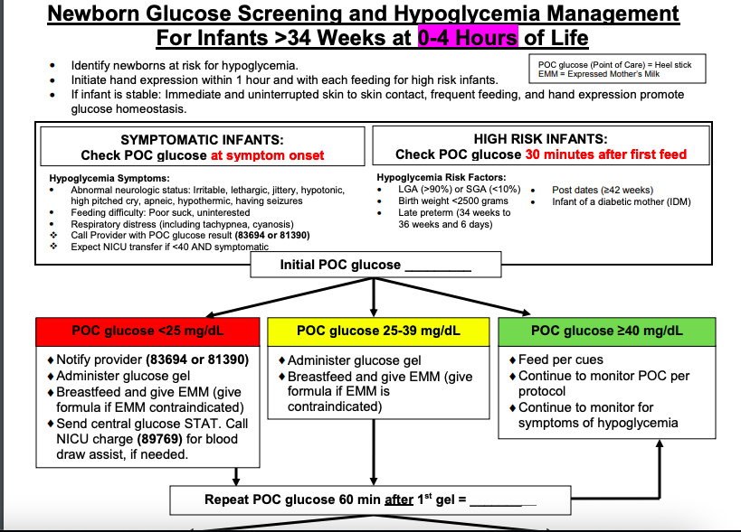
Glucose Gel Protocol Example - UWMC

Slide 17
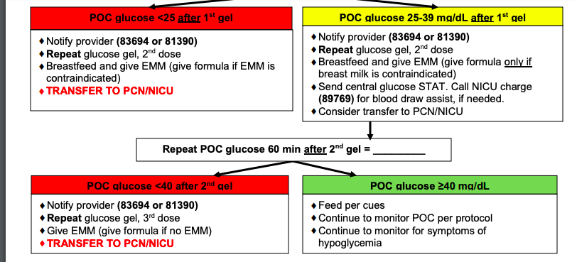
Glucose Gel Protocol Example - UWMC

Slide 18
Management: NICU/PICU Transfer
If BG levels remain low despite feeding and dex gel, or if infant is unable to tolerate feedings
IV dextrose
Evaluate for polycythemia, infection, perinatal asphyxia
Endocrine consult for persistent hypoglycemia (>48hrs)
Further lab testing:
lactic acid, ammonia, urinary ketones, hydroxybutyrate, free fatty acids, acylcarnitine
profile, plasma amino acids, and urine organic acids.

Slide 19
IDM – Infant of the Diabetic Mother

Slide 20
Infant of a Diabetic Mother: Pathophysiology
Peripheral insulin resistance
Decreased number of insulin receptors -> decreased binding of insulin to target cells
Progressive alteration in glucose tolerance
Significantly increased maternal insulin levels – up to 2-3 times normal
Frequent episodes of hyperglycemia, high levels of amino acids -> maternal glucose/amino acids transferred to fetus

Slide 21
Infant of a Diabetic Mother: Pathophysiology
Maternal insulin does not cross the placenta
Hyperglycemic episodes triggers high insulin production in fetus
Insulin like growth factors stimulate protein, lipid, and glycogen synthesis
Increased fetal growth, increased fat deposits, increased organ growth -> Macrosomia

Slide 22
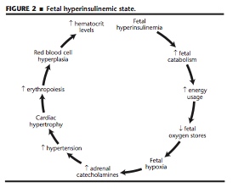
Fetal hyperinsulinemia
Excess fetal insulin causes catabolism, energy usage, hypoxia, increased catecholamines, hypertension, cardiac hypertrophy, erythropoiesis, and polycythemia.
(Fig from Barnes-Powell, 2007)

Slide 23
Neonatal Consequences: IDM/Macrosomia
Hypoglycemia: Termination of maternal elevated glucose supply and elevated neonatal insulin levels.
Metabolic: Hypocalcemia, hypomagnesemia due to decreased parathyroid function
Respiratory: Delayed surfactant production, persistent pulmonary hypertension -> Hypoxia
Asphyxia: Intrauterine hypoxia from abruption, placental insufficiency

Slide 24
Neonatal Consequences: IDM/Macrosomia
Birth trauma: Shoulder dystocia, brachial plexus injuries (Erb’s palsy, phrenic nerve damage), fractures (clavicular, humerus)
Polycythemia: Chronic hypoxia results in increased red blood cell production.
Congenital Malformations
Teratogenic metabolic environment
Cardiac, musculoskeletal, CNS
Death

Slide 25
Long Term Consequences: IDM/Macrosomia
Developmental or motor delays due to intrauterine affects on brain development
Perinatal asphyxia or seizures related to hypoglycemia
Permanent damage from birth trauma
Increased risk of adult obesity – 50% of infants of diabetic mothers have excessive growth, increased insulin resistance, and excessive glucose delivery later in life due to permanent glucose-insulin kinetic alterations

Slide 26
Summary
Hypoglycemia is a common newborn condition
Risk factors include size/weight, gestation, and maternal diabetes
Uncontrolled maternal diabetes can have short and long term consequences for the infant
Current AAP guidelines outline screening and recommend feeding as treatment for asymptomatic newborns
Glucose gel is an emerging treatment that has been proven effective in preventing NICU admissions

Slide 27
Case Study #2
A 39 week infant is born via c-section for non-reassuring fetal heart tones. Apgars are 8 and 9. The infant’s birth weight is 3846g.
Risk Factors?
As the PNP on duty, you assess the newborn at about 3 hours of life. The parents state they are concerned the infant is cold because he seems to be shivering a lot.
What is your next step?

Slide 28
Case Study #2 Continued
You check a blood glucose and it is 41. What should your next step be based on the AAP guidelines?
Feed and recheck in 1 hour
The nurse notifies you via page that the follow up blood glucose was 30. What orders will you give?
As infant is now 4 hours old, the BG level should be greater than 35. Transfer to NICU for IV fluids

Slide 29
References
Postnatal Glucose Homeostasis in Late-Preterm and Term Infants. Pediatrics. March 2011, Vol 127/Issue 3.
Barnes-Powell, L.L. (2007). Infants of diabetic mothers: The effects of hyperglycemia on the fetus and neonate. Neonatal Netw,26(5): 283-90.
Neonatal HypoglycemiaAlecia Thompson-Branch, Thomas Havranek. Pediatrics in Review Apr 2017, 38 (4) 147-157; DOI: 10.1542/pir.2016-0063
Glucose Gel in Infants at Risk for Transitional Neonatal Hypoglycemia. Makker K, Alissa R, Dudek C, Travers L, Smotherman C, Hudak ML. Am J Perinatol. 2018 Sep;35(11):1050-1056. doi:10.1055/s-0038-1639338. Epub 2018 Mar 26.
Alsaleem M, Saadeh L, Kamat, D. Neonatal Hypoglycemia: A Review. Clinical Pediatrics. 2019;58(13) 1381-1386.
Harris D, Gamble G, Weston P, Harding J. What happens to blood glucose concentrations after oral treatment for neonatal hypoglycemia. The Journal of Pediatrics. 2017; 190:136-41.
Romald J, Coda L, Rishi F, Khalil E. Oral glucose gel for neonatal hypoglycemia – a single hospital study. Pediatrics. 2019;144(2) 673.
Adamkin, D. Neonatal hypoglycemia. Seminars in Fetal and Neonatal Medicine. 2017;(22) 36-41.
Ter M, Halibullah I, Leung L, Jacobs S. Implementation of dextrose gel in the management of hypoglycaemia. Journal of Paediatrics and Child Health. 2016;53(2017)408-411.

